Slide 1

Covid Transmission preventing system for public queue

Slide 2
Introduction
The coronavirus is getting mutated and taking various forms such as the delta variant. So the third is not so far. So it becomes necessary to follow all the precautionary measures and protocols laid by the government during the initial stages of COVID-19.
So we should always be prepared for the worst case scenario and take necessary precautions. There are basically two ways in which the spread of coronavirus takes place that are respiratory droplets and physical contact.To avoid the spread of the virus social distancing and wearing masks become two important preventive measures.
The targeted audience for this system are common people. Aim is to develop a mask detection system and social distance monitoring system which can be maintained/supervised by the people themselves and can be used in queues like ATM’s, Vaccination Booths , etc.

Slide 3
Motivation :
People started to ignore covid as they get vaccinated thinking that they’re safer now.But the covid has already evolved into delta variant which transmits at a very faster rate and it can also affect the vaccinated people.
So it is a necessary duty of all the people in the world to follow covid transit prevention guidelines. This project will help the people in maintaining the covid norms in queues as in banks, atm’s ,vaccination booths,railway stations,etc.

Slide 4
Flowchart :
My drive link :
https://drive.google.com/file/d/1rRAJ_pJ5PQdQgAM7Jsa2nd8TR2F3wAlh/view?usp=sharing

Slide 5
Solution approach :
For temperature checking : Temperature sensor and proximity sensor
For mask detection : Convolution Neural Network (CNN) and opencv
For social distancing monitoring : Yolo model and opencv

Slide 6
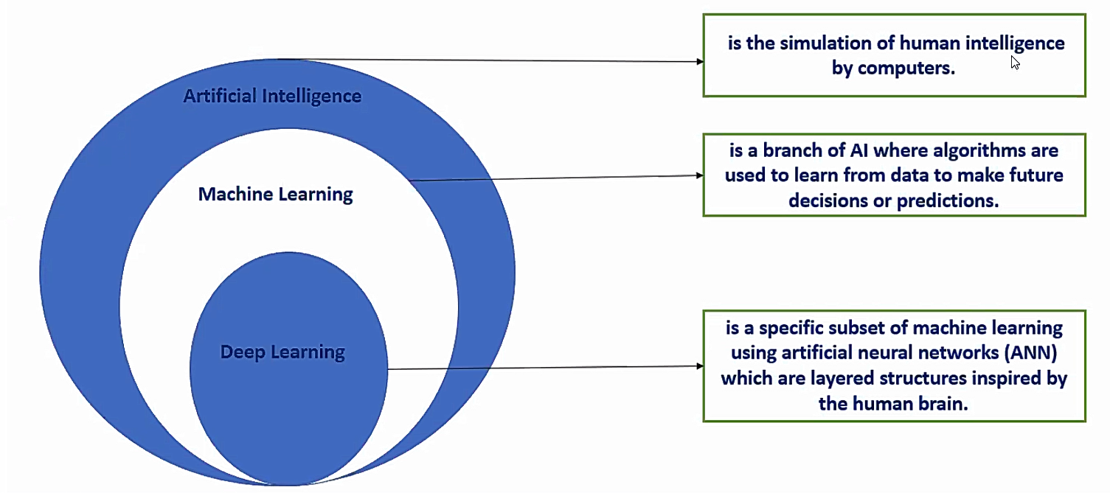
What is neural network ?

Slide 7
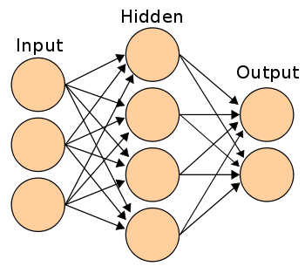
How does it work ?

Slide 8
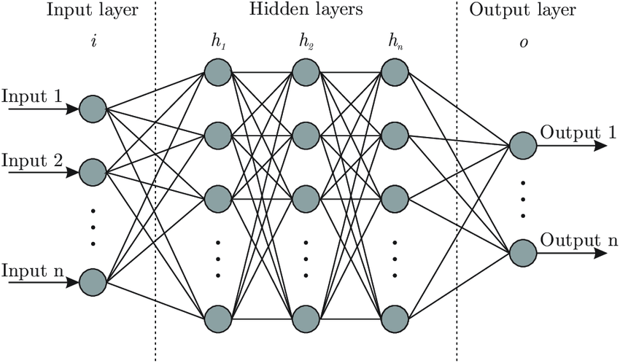

Slide 9
Why CNN instead of ANN ?
Convolution + pooling gives location invariant feature detection.
Reduces dimensions and computation and overfitting.
Speeds up training , faster to compute.
Makes the model tolerant towards small distortion and variations.

Slide 10
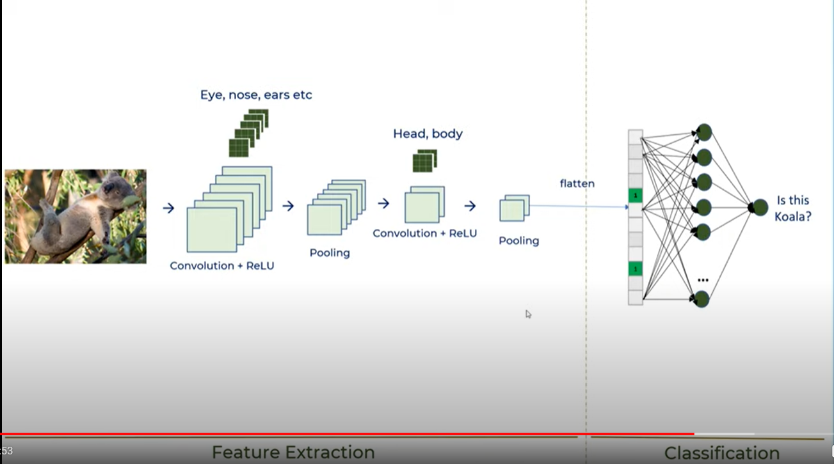

Slide 11
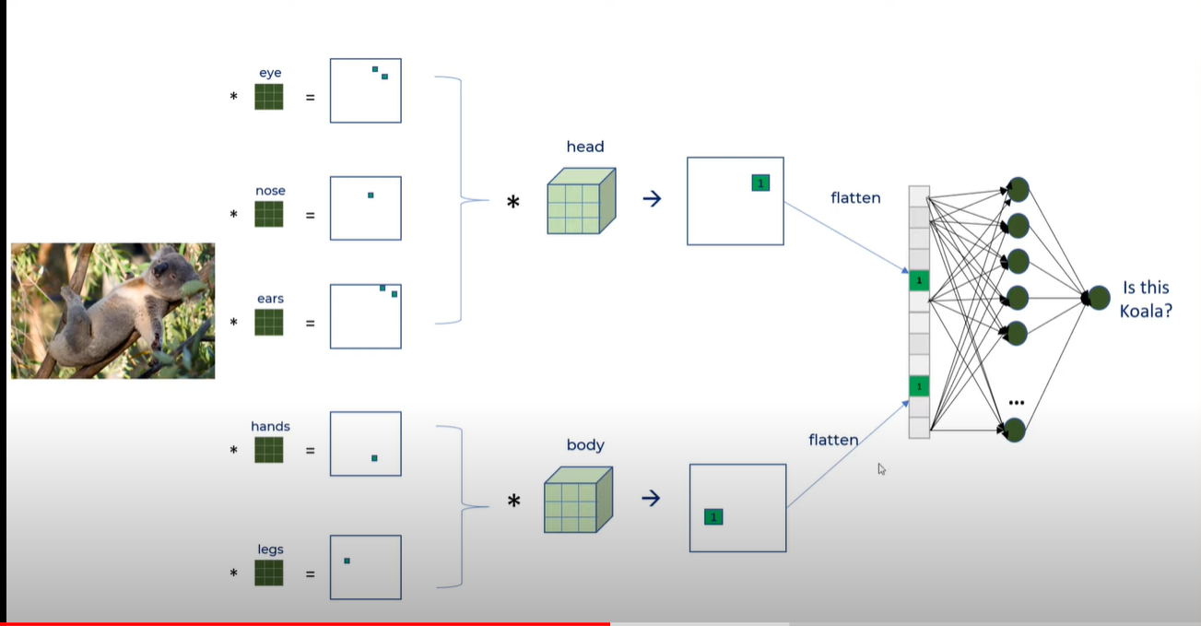

Slide 12
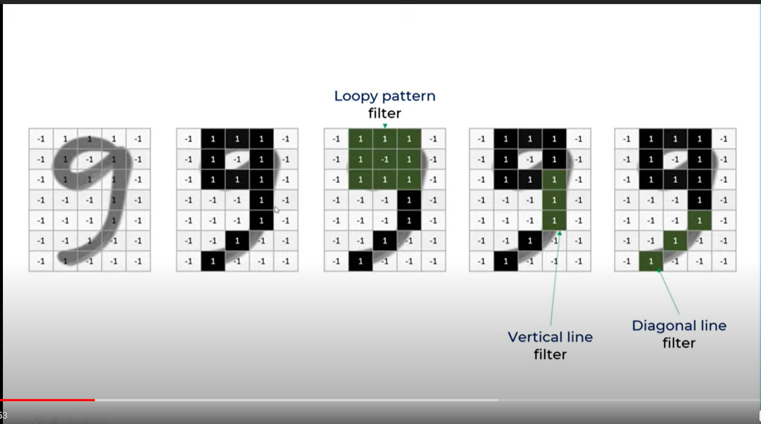

Slide 13
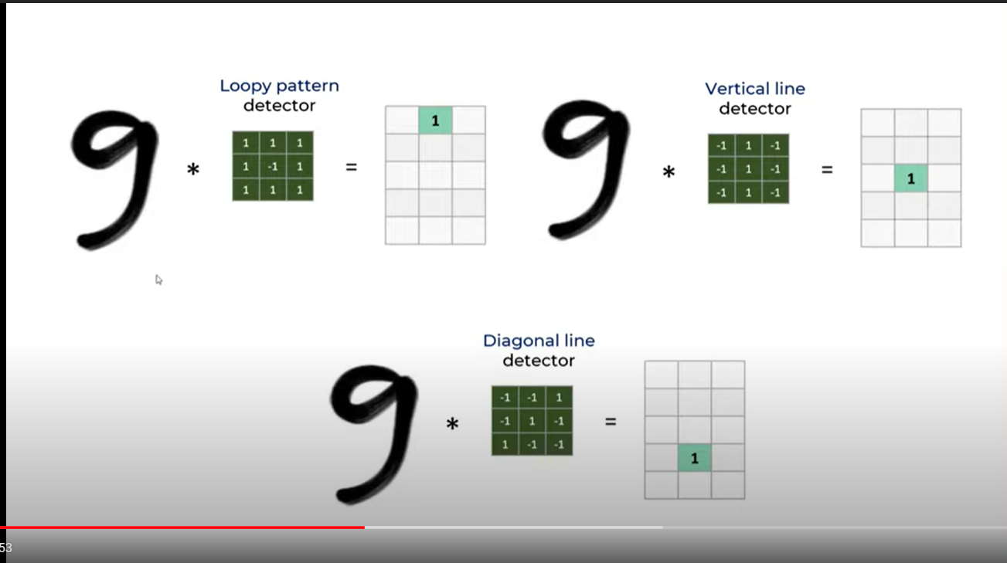
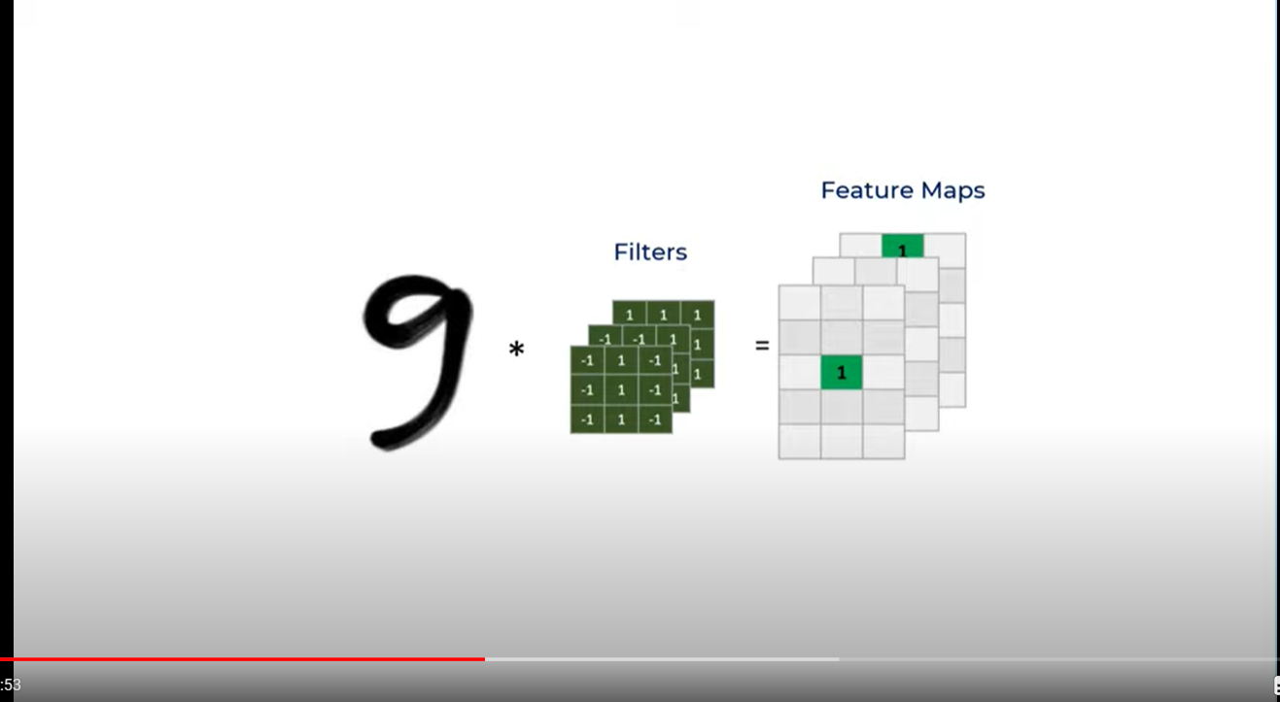

Slide 14
THANK YOU

